Slide 1

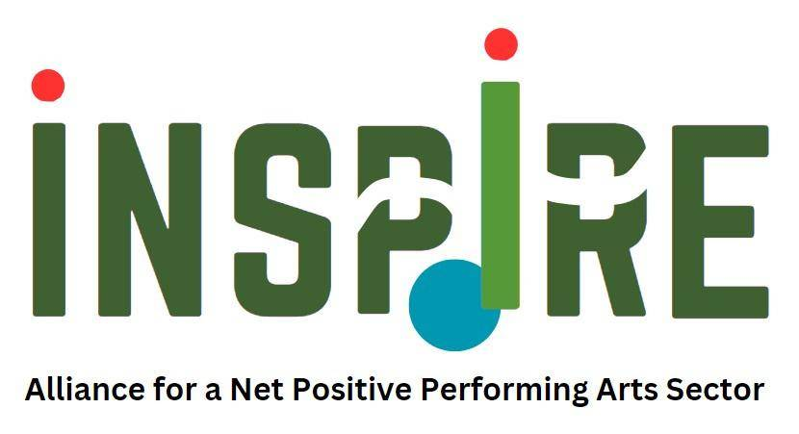



WP3
INSPIRE Practical Handbook
Chapter 2
Resilience and Soft Skills for Trainers

Slide 2

Lesson 1:
Building Resilience through Emotional Intelligence and People Management

Slide 3


Topics of Lesson 1
Trainer Preparation - Reading the Room: Understanding Yourself, Your Learners, and the Learning Environment
People Management skills with Training Tips
Leading & Motivating Performing Arts Teams
The Role of Emotional Intelligence in Building Resilience: Facilitation Support
Notes:
The key pillars of lesson 1 are:
Trainer Preparation - Reading the Room: Understanding Yourself, Your Learners, and the Learning Environment
People Management skills with Training Tips
Leading & Motivating Performing Arts Teams
The Role of Emotional Intelligence in Building Resilience: Facilitation Support

Slide 4
People Management Skills
Key Definitions:
Communication – The skill of expressing ideas clearly, listening actively, and ensuring information flows smoothly across the team. It is crucial for clarifying misunderstandings and maintaining team cohesion.
Leadership – The ability to inspire, guide, and make decisions while balancing artistic vision and team well-being. It plays a key role in resolving conflict and refocusing teams during challenges.
Adaptability – The capacity to adjust quickly to changing schedules, team dynamics, or creative direction. It is essential for maintaining continuity and productivity when facing unexpected disruptions.
Emotional Intelligence – The awareness and regulation of one’s own emotions while understanding and responding sensitively to others. It supports the creation of an inclusive, supportive team environment.
Resilience is what helps us stay grounded when facing setbacks. As a skill, it’s about handling pressure and regaining focus. As a competence, it’s about how we show up for others—staying steady, offering support, and adapting together through challenges.
Notes:
Key definitions of People Management - soft skills - are:
Communication – The skill of expressing ideas clearly, listening actively, and ensuring information flows smoothly across the team. It is crucial for clarifying misunderstandings and maintaining team cohesion.
Leadership – The ability to inspire, guide, and make decisions while balancing artistic vision and team well-being. It plays a key role in resolving conflict and refocusing teams during challenges. Adaptability – The capacity to adjust quickly to changing schedules, team dynamics, or creative direction. It is essential for maintaining continuity and productivity when facing unexpected disruptions.
Emotional Intelligence – The awareness and regulation of one’s own emotions while understanding and responding sensitively to others. It supports the creation of an inclusive, supportive team environment.
Resilience is what helps us stay grounded when facing setbacks. As a skill, it’s about handling pressure and regaining focus. As a competence, it’s about how we show up for others—staying steady, offering support, and adapting together through challenges.
Strong people management nurtures resilience by creating trust, leading with empathy, and keeping communication honest and clear when it matters most.
Examples from Across the Live Performance Sector:
Soft skills like emotional intelligence, adaptability, and collaborative leadership are essential across disciplines. Here’s how they show up in different contexts:
Dance: Emotional regulation supports performers through physical strain, expressive vulnerability, and ensemble synchrony.
Music: Adaptability helps ensembles respond to tempo shifts, improvisation, and live acoustics.
Circus arts: Trust and resilience are essential for managing risk, precision, and interdependence.
Spoken word: Empathy and listening foster connection across diverse lived experiences and cultural narratives.
Festivals: Clear communication and emotional agility help teams coordinate across venues, roles, and timeframes.
💡Take time to reflect on how conflict resolution tools can be adapted to the specific pace, roles, and pressures of each performing.

Slide 5
Leading & Motivating Performing Arts Teams
Types of Motivation
Intrinsic motivation: comes from within and involves engaging in an activity for its own sake, driven by internal satisfaction, passion, or personal fulfillment. In the performing arts, this includes:
Love of the craft and creative expression: Enjoying art creation (e.g., Artistic Director, Set Designer) or technical support roles.
Personal growth: Improving skills, challenging oneself, or trying new techniques.
Flow experience: Feeling fully immersed and energized during rehearsals or performances.
Extrinsic motivation: comes from outside and refers to external rewards such as money, recognition, or status.
Notes:
Recognizing and responding to both individual and collective motivation is a key aspect of effective team management. Sustaining motivation is especially important across different production phases—to communicate clearly, encourage and validate efforts, and maintain momentum.
There are two types of motivation:
Intrinsic motivation comes from within and involves engaging in an activity for its own sake, driven by internal satisfaction, passion, or personal fulfillment. In the performing arts, this includes:
Love of the craft and creative expression: Enjoying art creation (e.g., Artistic Director, Set Designer) or technical support roles.
Personal growth: Improving skills, challenging oneself, or trying new techniques.
Flow experience: Feeling fully immersed and energized during rehearsals or performances.
Extrinsic motivation, in contrast, comes from outside and refers to external rewards such as money, recognition, or status.

Slide 6
Leading & Motivating Performing Arts Teams
Shared Purpose: the foundation of effective collaboration. Understanding how to define roles, manage multidisciplinary teams, and lead both short-term projects and long-term initiatives is essential for success.
Team Dynamics
Unique aspect of PA context:
High pressure
Temporality
Creativity
Emotional labour
Roles
Risks of Poor Role Clarity
Conflicts
Overlapping roles
Accountability gaps
Diversity and Talent
Managing Multi-Disciplinary Teams
Working with External Collaborators
Notes:
Shared Purpose: Foundations for Effective Collaboration
In the performing arts, collaboration is not a choice—it's the foundation of every successful production. Effective teamwork requires practical strategies for smoothly managing team dynamics, clear role definitions, diversity, and talent management. These approaches help foster a healthy, inclusive working environment and guide collaboration toward fulfilling a shared sense of purpose and creative goals. Whether directing a production, coordinating a festival, or managing a venue, understanding how to define roles, manage multidisciplinary teams, and lead both short-term projects and long-term initiatives is essential for success.
Motivation and leadership manifest differently across the live performance landscape. In music ensembles, emotional awareness and clear communication help sustain energy and cohesion during long rehearsals or live improvisation. In dance companies, motivation is often tied to physical resilience, expressive clarity, and group synchrony. Festival teams, working across multiple venues and disciplines, rely on adaptability and shared purpose to maintain momentum under complex logistical pressures.
💡You, as a trainer, should consider how these sector-specific dynamics shape the way soft skills are applied and nurtured.
These dynamics apply across the performing arts:
in dance, core collaborators may include choreographers and rehearsal directors;
in music, ensemble leaders and sound technicians;
in festivals, site managers and artist liaisons.
Each context brings unique rhythms, hierarchies, and emotional labour.

Slide 7
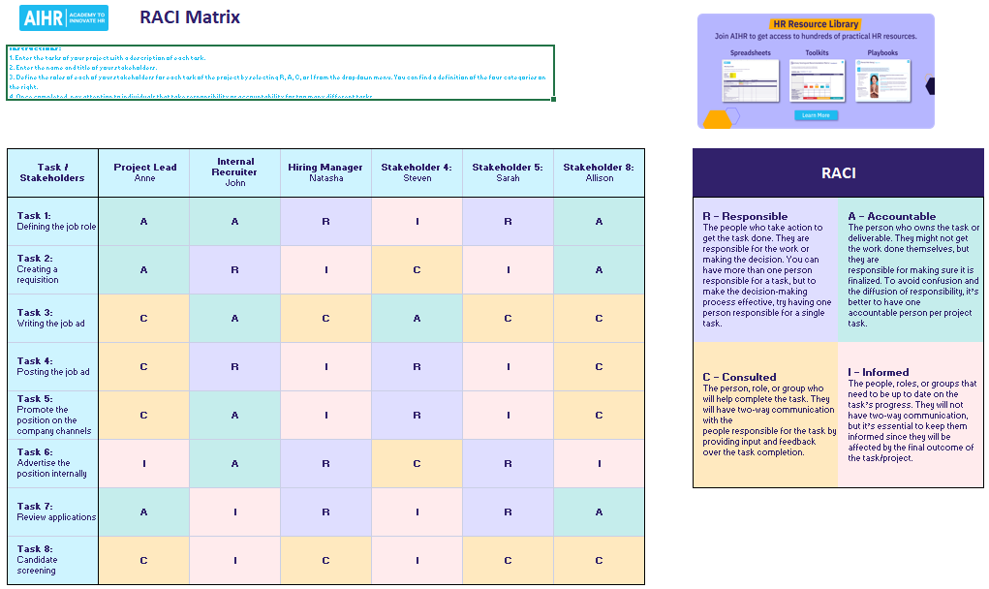
Notes:
Role clarity is essential whether you're coordinating a touring dance company, managing a multi-stage music festival, or producing a site-specific opera.
Tools like RACI Matrix help teams across disciplines define responsibilities transparently and avoid overlap or miscommunication.

Slide 8

Activity C2.A1
Applying the RACI Model in Performing Arts Teamwork
What were the discoveries or difficulties when trying to define R, A, C, and I for each role?
Were there any surprises in who you marked as "Accountable" (A) or "Responsible" (R)?
Do you feel this division of roles using RACI is realistic in your daily performing arts practice? Why or why not?
Notes:
Answer the questions:
What were the discoveries or difficulties when trying to define R, A, C, and I for each role?
Were there any surprises in who you marked as "Accountable" (A) or "Responsible" (R)?
Do you feel this division of roles using RACI is realistic in your daily performing arts practice? Why or why not?

Slide 9
Holding Teams Together: Essential Principles for Trust, Communication, and Cohesion
Key Principles | Team Rituals | Inclusion Practices
Psychological Safety Transparency Feedback Loops | Regular check-ins Reflections Informal social bonding | Language support Accessibility Cultural sensitivities

Slide 10
Talent Management: Key Stages Explained with Practical Guidance on Focus Areas
Talent Management Stages | Focus On
Recruitment Onboarding Development Performance Feedback Retention | Find and attract diverse, talented people through inclusive and diverse channels. Support new team members settle into teams and connect with the mission. Support skill-building, creativity, and career growth. Give clear, constructive feedback and encourage reflection to align creative efforts with shared goals. Create a supportive environment that values and motivates people and promotes well-being.

Slide 11
Talent Management: Key Stages Explained with Practical Guidance on Focus Areas
Types of Strength | How to identify? | Practical Tips
Creative and Technical (e.g. set design, production management, stage management, ) Interpersonal (e.g., mentoring others, conflict mediation, teamwork) Strategic (e.g., long-term planning, budgeting, coordinating logistics) Emotional (e.g., empathy, patience, remaining calm under pressure) | Observation: Notice where people naturally lead or excel. Conversations & Check-ins: Ask what they enjoy or feel effective at. Feedback Loops: Use 360° feedback from peers to discover talents. Reflection Tools: Use tools like Gallup StrengthsFinder, VIA Character Strengths, or informal mapping exercises. | Assign roles matching strengths. Encourage collaboration based on complementary skills. Rotate tasks for growth but keep core roles anchored. Celebrate strengths to boost motivation and loyalty.

Slide 12
Performing Arts Leadership: Innovation and Change Agency Framework
Successful arts leaders balance artistic integrity with practical management, inspiring creativity and ensuring stability while engaging diverse stakeholders.
Key Leadership Profiles:
Artistic: Leads creative vision.
Managerial: Focuses on operational efficiency.
Project: Balances creative and operational execution.
Commercial: Prioritizes profitability alongside mission.
Distinguishing Organizational Contexts:
Mission Focus: Non-profits prioritize mission; commercial entities balance mission with profit.
Resource Constraints: Non-profits rely on fundraising; commercial entities on sales.
Diversity of Stakeholders: Leaders navigate varied groups (donors, boards, audiences, staff).
Notes:
Innovation in performing arts requires informed decision-making for lasting organizational change. Leadership roles must adapt.
Key Leadership Profiles: enable understanding the primary leadership roles and organizational contexts in performing arts.
Artistic: Leads creative vision.
Managerial: Focuses on operational efficiency.
Project: Balances creative and operational execution.
Commercial: Prioritizes profitability alongside mission.
Distinguishing Organizational Contexts:
Mission Focus: Non-profits prioritize mission; commercial entities balance mission with profit.
Resource Constraints: Non-profits rely on fundraising; commercial entities on sales.
Diversity of Stakeholders: Leaders navigate varied groups (donors, boards, audiences, staff)

Slide 13
Leadership Styles and Strategic Application
Leadership style | Description | Traits | Strength
Directive | Top-down, leader-made decisions. | Authoritative, structured, task-focused. | Precision, efficiency.
Collaborative | Leaders work closely with teams. | Inclusive, communicative, relationship-oriented. | Creativity, artistic experimentation
Transformational | Leaders inspire ambitious goals | Visionary, charismatic, change-driven. | Pushes boundaries, redefines norms.
Servant | Leaders prioritize team well-being. | Empathetic, supportive, ethical. | Builds strong communities, ensures inclusivity.
Notes:
Leadership Style Profiles and Strategic Application: introduces to the behaviors, traits, and strengths leaders use to effectively guide teams and projects.

Slide 14
Key Leadership Traits for Effective Decision-Making: |  | Essential Decision-Making Strategies:
Holding Teams Together | Strong communication, encouragement, conflict resolution. Fosters creativity and value. | Gather Information | Involve experts for meaningful dialogue.
Leading by Example | Professionalism, strong work ethic, clear creative vision. Builds trust, motivates. | Evaluate Options | Assess risks, benefits, outcomes thoroughly.
Strategic Thinking | Swift problem-solving, adapting to challenges, informed decisions. Ensures resilience and vision alignment. | Make & Communicate the Decision | Clearly articulate chosen path and reasoning for alignment.
 |  | Review & Adapt | Reflect on results to learn and improve future decisions.
Leadership and Decision-Making
Leaders provide vision and direction, guiding teams and making timely decisions that shape productions.
Notes:
Leadership Type and Decision-Making: explores how leadership styles shape decision-making
Examples:
Successful arts leaders balance artistic integrity with practical management, inspiring creativity and ensuring stability while engaging diverse stakeholders.
Strong leadership with sound decision-making are fundamental to performing arts success. Leaders provide vision and direction, guiding teams and making timely decisions that shape productions.
Effective leadership blends styles with high emotional intelligence for a flexible, responsive approach.
Visionary leadership guides organizations in dynamic environments by setting clear, ambitious goals.

Slide 15
Agent-of-Change Spirit: Leading Transformation from Within
Interconnected soft skills | Core Components
Emotional Intelligence & Self-Awareness | Understanding self, managing emotions, empathizing.
Strategic Thinking & Problem-Solving | Assessing challenges, executing vision, fostering innovation.
Communication & Influence | Articulating visions, active listening, inspiring through storytelling.
Adaptability & Resilience | Navigating uncertainty, embracing change, learning from failures.
Collaboration & Relationship Building | Strengthening partnerships, encouraging inclusivity, building cohesive teams.
Innovative Mindset | Identifying opportunities, taking initiative, balancing risk with execution.
Notes:
Agent-of-Change Spirit: Leading Transformation from Within
In the performing arts, true innovation comes from leaders who serve as agents of change. They challenge traditions, reimagine roles, and pioneer new approaches through a proactive, learning-oriented mindset.
Agents-of-change require strong communication, resilience, and collaboration to reshape organizational culture and artistic practice. Purposeful leadership development fosters the bridge from adaptive leadership to change-making, equipping leaders to navigate complexity creatively..
Following key interconnected soft skills empower leaders with both creative vision and operational clarity, enabling the journey from adaptive leader to true change-maker.
Building on understanding the artistic, project, commercial, and managerial leadership profiles, this framework highlights how these pillars interact with different leadership behaviors and contexts.
The blend of vision, accountability, and change agency nurtures leaders prepared for the evolving challenges of performing arts organizations.
Central to this are the interconnected soft skills that enable leaders to navigate complexity and lead with confidence.

Slide 16
The Role of Emotional Intelligence in Building Resilience
the ability to understand and manage your own emotions while recognizing and influencing the emotions of others
Why does it matter?
Self-Awareness: Helps people notice their emotions early, so they can manage stress before it builds.
Self-Regulation: Keeps individuals calm and focused under pressure, avoiding impulsive reactions.
Motivation: Fuels persistence, helping people stay committed and energized despite setbacks.
Empathy: Builds understanding and support, making the team feel safe and connected.
Social Skills: Improves teamwork, communication, and conflict resolution for stronger, adaptable teams.
Notes:
The Role of Emotional Intelligence in Building Resilience
Why does it matter?
Emotional intelligence (EI) is the ability to understand and manage your own emotions while recognizing and influencing the emotions of others. It is a vital skill set in the performing arts, where collaboration, emotional expression, and interpersonal dynamics are at the heart of daily work. EG helps teams stay grounded, connected, and adaptable.
How do the 5 components of emotional intelligence build resilience?
Each of the five components supports resilience by helping individuals and teams manage emotions, stay motivated, build strong connections, and adapt effectively to challenges.
Self-Awareness What it does: Helps people notice their emotions early, so they can manage stress before it builds. Tip: Use quick self-check exercises to help participants recognize their feelings in real time.
Self-Regulation: What it does: Keeps individuals calm and focused under pressure, avoiding impulsive reactions. Tip: Practice breathing or pause techniques to manage emotional reactions during stressful moments.
Motivation: What it does: Fuels persistence, helping people stay committed and energized despite setbacks. Tip: Encourage sharing personal goals and sources of passion to strengthen intrinsic motivation. 4. Empathy: What it does: Builds understanding and support, making the team feel safe and connected. Tip: Use role-play or storytelling to practice seeing situations from others’ perspectives.
5. Social Skills: What it does: Improves teamwork, communication, and conflict resolution for stronger, adaptable teams. Tip: Facilitate group activities that require collaboration and constructive feedback.
EXERCISE :
Scenario-Based Exercise - Applying Emotional Intelligence (EI) to Build Resilience
Ask learners to identify which of the five EI components they would apply in the following scenario- prompt (below) and reflect on the impact. Feel free to use Clues for Reflection for your support.
Scenario Prompt During a rehearsal, a performer becomes visibly frustrated and disengaged after receiving critical feedback. Tension rises in the group. As the trainer, how do you respond using emotional intelligence to restore trust and motivation?
Clues for Reflection
Identify key emotional intelligence components.
Describe response: actions, words, and approach to both the individual and the group.
Reflection Prompts - How did emotional regulation or empathy influence the outcome? - How does your own emotional awareness shape your facilitation style? - What strategies could help you stay grounded under pressure?

Slide 17
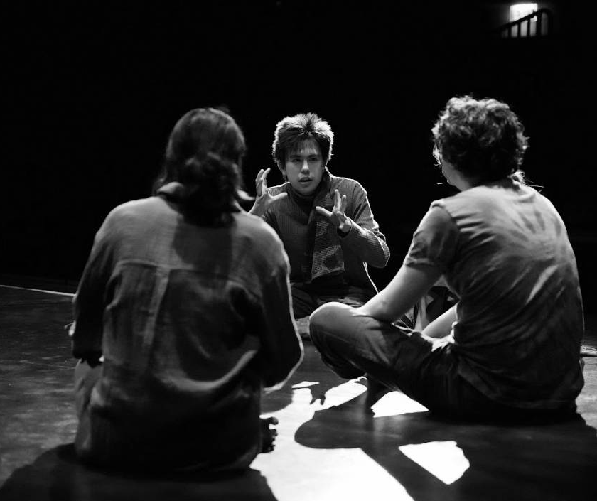
Lesson 2:
Leading and Collaborating in Teams: Vision, Conflict, and Change

Slide 18
Topics of Lesson 2
Trainer Preparation - Leading the Room: Navigating Group Dynamics and Balancing Roles
Communicating and Collaborating in Teams
Problem Solving and Conflict Management: Toolbox with Scenario-Based Exercise
Negotiation and Change Management: Foundations and Facilitation Strategies
Notes:
The key pillars of lesson 2 are:
Trainer Preparation - Leading the Room: Navigating Group Dynamics and Balancing Roles
Communicating and Collaborating in Teams
Problem Solving and Conflict Management: Toolbox with Scenario-Based Exercise
Negotiation and Change Management: Foundations and Facilitation Strategies

Slide 19

Communicating and Collaborating in Teams
Collaborative Roles and Shared Vocabulary Framework
Collaborative Roles
Artistic Team: Visionaries shaping the narrative, visuals, and emotional landscape (e.g., Artistic Director, Set Designer). They focus on what and why.
Technical Team: Executes artistic visions into operational realities (e.g., Production Manager, Stage Manager, Technician (Stage technicians, Facilities Manager, ). They focus on how, considering practicalities like budget and safety.
Team Diversity: Productions use both stable permanent teams and agile temporary (project-based) teams, influencing collaboration dynamics.
Skills like curiosity, empathy, flexibility, observation, and active listening help create the trust and openness needed to build a shared vocabulary across diverse roles.
Notes:
In performing arts, collaboration involves working with artists, technicians, producers, and educators. These roles bring different experiences and career paths to the team. This diversity contributes to the work but can also cause misunderstandings if there is no shared understanding. Therefore, building mutual respect, clear communication, and common ground is necessary for effective teamwork.
To support that, it’s helpful to ask:
How do we connect creative ideas with technical know-how?
How do we recognize and value the different strengths each person brings?
How can we better understand what others are responsible for—and how that affects the bigger picture?
Can we build a shared language that helps us work together more smoothly and respectfully?
Collaborative Roles and Shared Vocabulary Framework
Collaboration between artistic and technical teams is fundamental in order to ensure that creative visions become tangible realities. It requires a clear role understanding, strong communication, and a common language.
Collaborative Roles
Artistic Team: Visionaries shaping the narrative, visuals, and emotional landscape (e.g., Artistic Director, Set Designer). They focus on what and why.
Technical Team: Executes artistic visions into operational realities (e.g., Production Manager, Stage Manager, Technician (Stage technicians, Facilities Manager, ). They focus on how, considering practicalities like budget and safety.
Team Diversity: Productions use both stable permanent teams and agile temporary (project-based) teams, influencing collaboration dynamics.
When Collaboration Begins:
Effective collaboration starts early—at the conception and planning stage—when it’s essential to build mutual understanding and open channels for clear communication. At this stage, soft skills play a crucial role.
Skills like curiosity, empathy, flexibility, observation, and active listening help create the trust and openness needed to build a shared vocabulary across diverse roles. Rather than focusing on mastering all technical or artistic terms, the emphasis should be on the willingness to ask questions, provide explanations, and build common understanding.
Examples:
An artistic team might benefit from learning terms like Cue Sheet, Rigging, or DMX.
A technical team might become more attuned to concepts like Blocking, Mood and Tone, or Stage Picture.
Beyond vocabulary, attitudes of respect, patience, and curiosity are key to successful collaboration.

Slide 20
Developing Communication Competence: Principles, Active Listening Techniques, and Feedback Mechanisms
Core Communication Principles:
Shared Understanding: Create common ground for all team members to understand the overall vision and can anticipate each other’s actions.
Clear Role Definition: Ensure everyone—from Artistic Directors to Technicians—understands their specific responsibilities.
Regular Feedback: Implement structured feedback loops to address issues promptly and adjust plans.
Team Training: Use rehearsals and workshops to strengthen both technical skills and interpersonal dynamics and mutual respect.
Notes:
Developing Communication Competence: Principles, Active Listening Techniques, and Feedback Mechanisms
Core Communication Principles:
Shared Understanding: Create common ground for all team members to understand the overall vision and can anticipate each other’s actions.
Clear Role Definition: Ensure everyone—from Artistic Directors to Technicians—understands their specific responsibilities.
Regular Feedback: Implement structured feedback loops to address issues promptly and adjust plans.
Team Training: Use rehearsals and workshops to strengthen both technical skills and interpersonal dynamics and mutual respect.
Soft Skills Matter! Principles only work when grounded in empathy, adaptability, sensitivity, and the ability to handle conflict calmly. These soft skills are essential for:
Building trust
Keeping communication open
To make things run smoothly
Resolving tensions as they arise.

Slide 21
Multi-faceted strategies to communication:
Core Communication Categories::
Strategic Interactions & Feedback
Communication Methods and Channels
Collaborative Problem-Solving
Active listening Key techniques:
Maintain Full Presence
Clarify Understanding
Encourage Elaboration
Reflect Feelings and Content
Key Feedback Mechanisms:
Be specific
Focus on Behaviour, Not Personality
Balance Positives & Improvement
Time It Right: Give feedback promptly and privately when possible.
Collaborate on Solutions
Practice to be Empathetic
Follow Up
Notes:
Multi-faceted strategies to communication:
For the communication category Strategic Interactions & Feedback
The following strategies are suggested:
1.Regular Updates & Meetings: Keep everyone informed.
2. Facilitators: Mediate misunderstandings.
3. Feedback Cycles: Structured spaces (e.g., post-rehearsal reviews) for transparent feedback, fostering ownership.
Why it matters? It ensures continuous alignment, addresses issues proactively, promotes clear communication channels, and builds a culture of transparency.
While for the Communication Methods and Channels - principle the four following strategies are important to practices as:
1.Verbal: Pre-briefings, standardized terms, structured feedback, on-the-fly coordination, facilitated meetings.
2. Non-Verbal: Body language, visual signals, gestures.
3. Written: Production briefs, technical riders, meeting minutes, digital platforms for documentation & archival.
4. Digital Tools: Shared calendars, chat, file-sharing platforms for transparency.
Why it matters? These strategies provide diverse channels for information flow, ensures clarity and reduces ambiguity, reinforces understanding through multiple senses, and creates a reliable record of decisions and plans. Trainers can highlight the importance of each type in specific scenarios.
And for the third category - Collaborative Problem-Solving - apply:
1. Simulation Exercises: Imagining scenarios and addressing real-life situations
2. Co-Designing Sessions: Bringing different perspectives on the table collaboratively.
3. Structured Workshops & Joint Meetings: Making sure everyone is included.
Why it matters? Because encourages early problem-solving, bridges creative and technical perspectives, and builds alignment through shared learning and decision-making.
—
Active listening Key Techniques
Active listening is paying deep attention to both words and nonverbal cues (tone, facial expressions, body language). It's about understanding the intent behind a message in order to build trust, strengthen teamwork, and enhance communication—creating a safe space for collaboration, encouraging open dialogue, and deepening understanding across diverse roles.
7 Key Feedback Mechanisms: Feedback helps shape ideas, keeps communication clear, encourages creative thinking, and builds trust between artistic and technical teams. It matters because:
Feedback is a part of the collaborative nature of the performing arts. It challenges assumptions and inspires solutions filled with creativity and trust.
It is an active process that sharpens expression and invites inputs to refine ideas.
Encourages openness and creates a supportive environment where people feel safe to share ideas, give input, take creative risks, and align artistic vision with technical execution
Examples :
(Focus on clear actions, not vague impression) e.g., "Lighting was delayed by 10 minutes," not "The scene felt off"
(Keep feedback fair and neutral) e.g., Instead of "You're disorganized," say "The prop wasn't in place for the last transition.”
(Be clear without sugarcoating) e.g., "Your energy in the opening scene was fantastic, and the vocal clarity could be stronger in the final monologue."
(Timeliness and Privacy) e.g. Discuss a missed lighting cue with the technician immediately after rehearsal, in a quiet corner, not during a full cast meeting.
(Shared Ownership and Future-Oriented Action). E.g. Ask, "How can we avoid this next time?" instead of placing blame.
(Recognize challenges and offer support). E.g. “I know the quick changes are challenging. What can we adjust in the set change to make it smoother for you?”
(Ensure feedback leads to progress, demonstrating care. Accountability) E.g. A week later, check in: "How are the new stage markings working out for your entrance?"

Slide 22
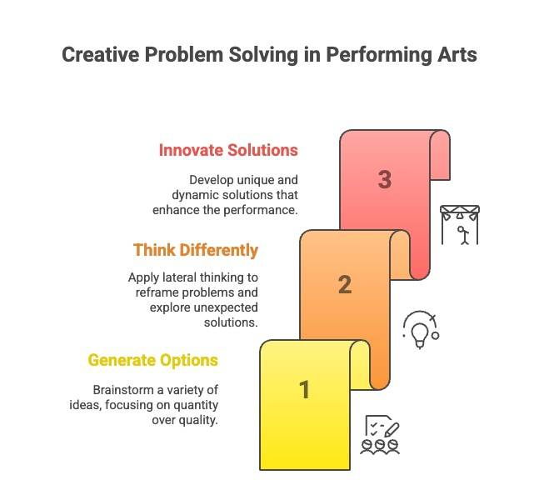
Problem Solving and Conflict Management: Toolbox
Problem Solving
the ability to transform chaos into success, ensuring momentum and preserving the performance's integrity.
The Core Mindset: Finding Creative Solutions
The Team Aspect:
Manage Emotions Constructively
Cultivate Respect During Brainstorming
Foster Psychological Safety
Notes:
Problem Solving and Conflict Management
The performing arts operate in a world of constant unpredictability. It requires an extraordinary capacity for quick thinking and problem-solving. Problem solving is the ability to transform chaos into success, ensuring momentum and preserving the performance's integrity.
Problem Solving
i. The Core Mindset: Finding Creative Solutions (Image)
ii. The Team Aspect: Problem-solving is a team effort that involves constructively managing both emotions and ideas, especially under pressure:
Manage Emotions Constructively: Channel stress into collaboration, not conflict. Create a space where frustrations are voiced respectfully and transformed into actionable solutions
Cultivate Respect During Brainstorming: All initial ideas, no matter how unconventional, deserve consideration. Prematurely shutting down suggestions stifles creativity and erodes trust.
Foster Psychological Safety: Encourage diverse perspectives and open dialogue. This enables individuals to share ideas freely, sparking innovative thinking.

Slide 23
Problem Solving and Conflict Management
Conflict Management
resolving disagreements in a demanding, collaborative environment to ensure conflicts don't disrupt the creative process or production success.
Conflict Behaviors (Approaches)
Collaborating
Avoiding
Accommodating
Competing
Compromising
Conflict Resolution Techniques
Effective Communication
Active Listening
Negotiation & Mediation
Emotional Intelligence
Clear Role Definition
Time Management
Focus on Shared Goals
De-escalation Techniques
Reframing
Calming Methods
Notes:
Conflict Management in performing arts is about resolving disagreements in a demanding, collaborative environment to ensure conflicts don't disrupt the creative process or production success.
EXERCISE: Scenario-based Exercise: Facilitating Conflict Resolution in a Creative Team
Ask learners to outline which conflict resolution strategies they would apply and reflect on how their approach promotes inclusive decision-making, intergenerational understanding, and soft skill development in collaborative performing arts environments. Feel free to use Clues for Reflection for your support.
Scenario Prompt:
During a final tech rehearsal for a youth-led contemporary opera production, the stage director (a young emerging artist) requests a dramatic lighting shift to intensify a climactic scene. The lighting designer, a seasoned technician, pushes back, citing safety risks and the need for recalibration time. The exchange grows tense: the director feels unheard, the designer feels dismissed, and the rest of the team becomes visibly uncomfortable. As the trainer overseeing this collaborative process, how do you intervene using conflict resolution tools to restore trust, clarity, and creative flow?
Clues for Reflection
Identify the most relevant conflict management tools (e.g., active listening, reframing, mediation).
Describe how you would support both the emerging director and the experienced technician while addressing the wider team’s discomfort
Reflection Prompts:
What were the underlying causes of the conflict in this scenario?
How would you mediate between the parties involved?
What soft skills (e.g., active listening, adaptability) would you prioritize?
How can you create space for resolution without forcing agreement?
What would you do differently if this happened in your own training context?
Note: Always reflect and adapt conflict resolution tools to suit the pace, roles, and pressures specific to each context within the diverse landscape of the live performance sector.

Slide 24
Negotiation and Change Management: Foundations and Facilitation Strategies
Negotiation
A fundamental life skill, naturally used daily, but often underutilized professionally.
In the performing arts, it's a conversation, a give-and-take to find common ground that ensures all parties feel heard, respected, and satisfied.
Negotiation techniques
PULL Communication
Change Management
In the unpredictable performing arts sector, managing change requires trust, resilience, and agility to transform challenges into growth.
The essentials for foundations of change are trust & resilience for navigating change purposefully and teams can grow through it.
Embracing Agility
Navigating Transitions: The Bridges Model
Tool for Continuous Improvement: The PDCA Cycle (Plan–Do–Check–Act cycle)
Notes:
Negotiation Management
Negotiation is a fundamental life skill, naturally used daily, but often underutilized professionally. In the performing arts, it's a conversation, a give-and-take to find common ground that ensures all parties feel heard, respected, and satisfied. Constructive negotiation is about building stronger relationships and lasting solutions.
Negotiation Techniques - to promote clarity, flexibility, and mutual benefit.
PULL Communication: A communication style that actively seeks to understand others' perspectives, inviting openness, curiosity, and constructive dialogue to transform differences into collaborative agreements, rather than pushing arguments or reacting defensively.
Change Management
Core Idea: In the unpredictable performing arts sector, managing change requires trust, resilience, and agility to transform challenges into growth. The essentials for foundations of change are trust & resilience for navigating change purposefully and teams can grow through it.
i. Embracing Agility:
Mindset: Flexible, step-by-step approach. Learning by Doing (test, adapt, improve).
Scrum Framework (Practical Tools):
Iterative Development (Sprints): Short work cycles for rapid adaptation.
Visibility & Adaptability: Regular check-ins for transparency.
Cross-Functional Teams: Diverse collaboration.
Role Clarity & Accountability: Structured team roles.
Responding to Stakeholders: Audience/stakeholder-centered projects.
Continuous Improvement: Retrospectives for learning and betterment.
ii. Navigating Transitions: The Bridges Model
Focus: Addresses the emotional impact of change on individuals.
Three Phases of Transition:
Ending, Losing, & Letting Go: Reactions (fear, resistance). Support: Empathy, acknowledging loss.
The Neutral Zone: "In-between" (confusion, frustration). Support: Safe space, clear short-term goals.
The New Beginning: Acceptance, new routines (positive). Support: Celebrating wins, clarifying roles.
iv. Tool for Continuous Improvement: The PDCA Cycle (Plan–Do–Check–Act cycle)
Focus: Practical loop for continuous learning and iteration. Ideal for dynamic environments.
Cycle Steps:
Plan: Identify change, set objectives.
Do: Pilot, support team.
Check: Evaluate what worked/didn't.
Act: Refine plan, embed improvements.

Slide 25
Activity C2.A1
Navigating Change as Agile Trainers

Slide 26
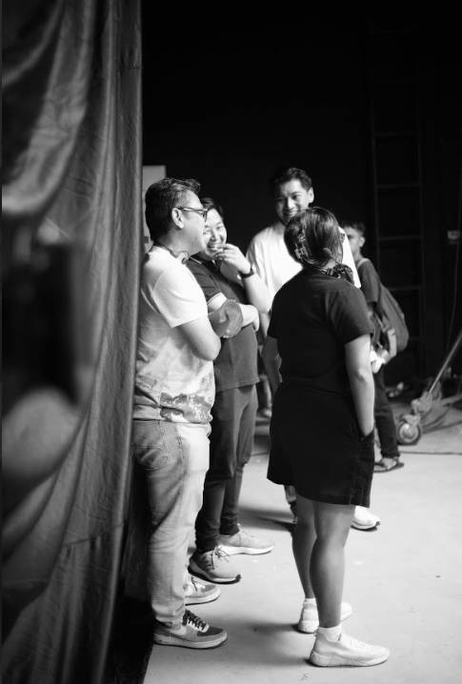
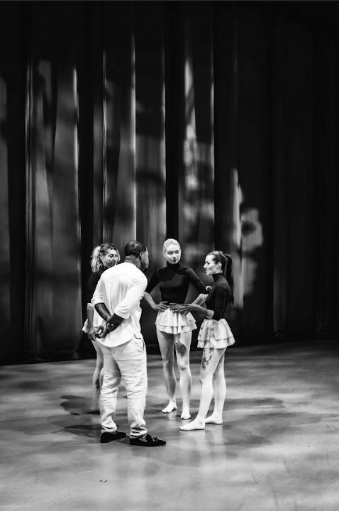
Lesson 3:
Power, DEI & Resilience: Understanding Complexity and Adaptability

Slide 27
Topics of Lesson 3
Trainer Preparation - Learning in the Room: Designing Inclusive Learning Environments and Engaging Participants
Navigating Power Relations
DEI Concepts and Strategies
Building an Adaptive Mindset and Resilience: Practical Advice and Strategies
Notes:
The key pillars of lesson 3 are:
Trainer Preparation - Learning in the Room: Designing Inclusive Learning Environments and Engaging Participants
Navigating Power Relations
DEI Concepts and Strategies
Building an Adaptive Mindset and Resilience: Practical Advice and Strategies

Slide 28
Navigating Power Relations and Discrimination
Where Power Resides:
Informal Hierarchies
Unspoken Rules & Cultural Norms
Informal Networks
Gatekeepers
External Influences
Why Understanding Power Matters for Teams:
Impact on Collaboration
Decision-Making
Inclusion & Exclusion
Discrimination
Notes:
Understanding Power Relations in the Performing Arts
Power shapes every aspect of the performing arts, from a project's inception to its audience reception. Understanding these dynamics creates space for more equitable and effective collaboration. Addressing power relations is key to empowering learners and their teams to build inclusive, transparent, and genuinely successful working environments. The key lies in understanding where and why power dynamics emerge—and how to adapt to navigate them.
i. Where Power Resides: Power isn't just formal (hierarchies, funding bodies etc). It also exists subtly in:
Informal Hierarchies: Based on experience, visibility, reputation, or control over resources (e.g., technical tools, rehearsal time).
Unspoken Rules & Cultural Norms: The "invisible curriculum" of expected behaviors (e.g., always saying "yes," avoiding unsolicited notes), which can reinforce hierarchy and silence discomfort.
Informal Networks: "Who you know" circles that shape job opportunities, collaborations, and access, often excluding those without insider connections.
Gatekeepers: Individuals or institutions (schools, agents, casting directors ) and digital systems who control access to resources, visibility, and career progression, often using subjective criteria that can reinforce existing biases (e.g., social media algorithms, AI tools, streaming platforms).
External Influences: Funders, critics, or community stakeholders can significantly sway internal decisions.
ii. Why Understanding Power Matters for Teams:
Impact on Collaboration: Unspoken or unbalanced power can lead to misunderstandings, delays, frustration, and limited participation. Awareness leads to smoother, more productive teamwork.
Decision-Making: Power dynamics dictate "who gets to decide" and whose voice carries weight, even outside formal roles.
Inclusion & Exclusion: Power structures profoundly affect who feels they belong, are heard, hired, or included. They can maintain imbalances even with formal equality policies.
Discrimination: Unbalanced power facilitates discrimination, whether explicit (direct acts), subtle (microaggressions, unconscious bias), or structural (institutional norms, representation gaps, socioeconomic barriers).

Slide 29

Navigating Power Relations and Discrimination
How to Adapt in Order to Foster Equitable Dynamics in Practice?
Promote Awareness
Challenge the Unspoken
Advocate for Transparency
Encourage Inclusive Networks
Empower Constructive Action:
Speak Up
Question Criteria
Document & Advocate
Build Support
Notes:
How to Adapt in Order to Foster Equitable Dynamics in Practice? 📌 Trainer Focus:
Promote Awareness: Encourage learners to critically ask: "Who decides? Whose voice carries weight? Who benefits from unspoken norms? Whose voices are missing?"
Challenge the Unspoken: Guide discussions around "professionalism" and cultural norms to identify and question exclusionary practices.
Advocate for Transparency: Guide to seek clarity in decision-making processes and resource distribution.
Encourage Inclusive Networks: Stress the importance of intentionally expanding professional circles beyond familiar faces to foster diversity.
Empower Constructive Action:
Speak Up: Encourage assertive (not aggressive) communication to address observed discrimination or imbalances.
Question Criteria: Challenge vague selection criteria and propose inclusive alternatives.
Document & Advocate: Teach the importance of documenting incidents and pushing for systemic policy changes.
Build Support: Emphasize seeking and offering support when navigating challenging power dynamics.

Slide 30
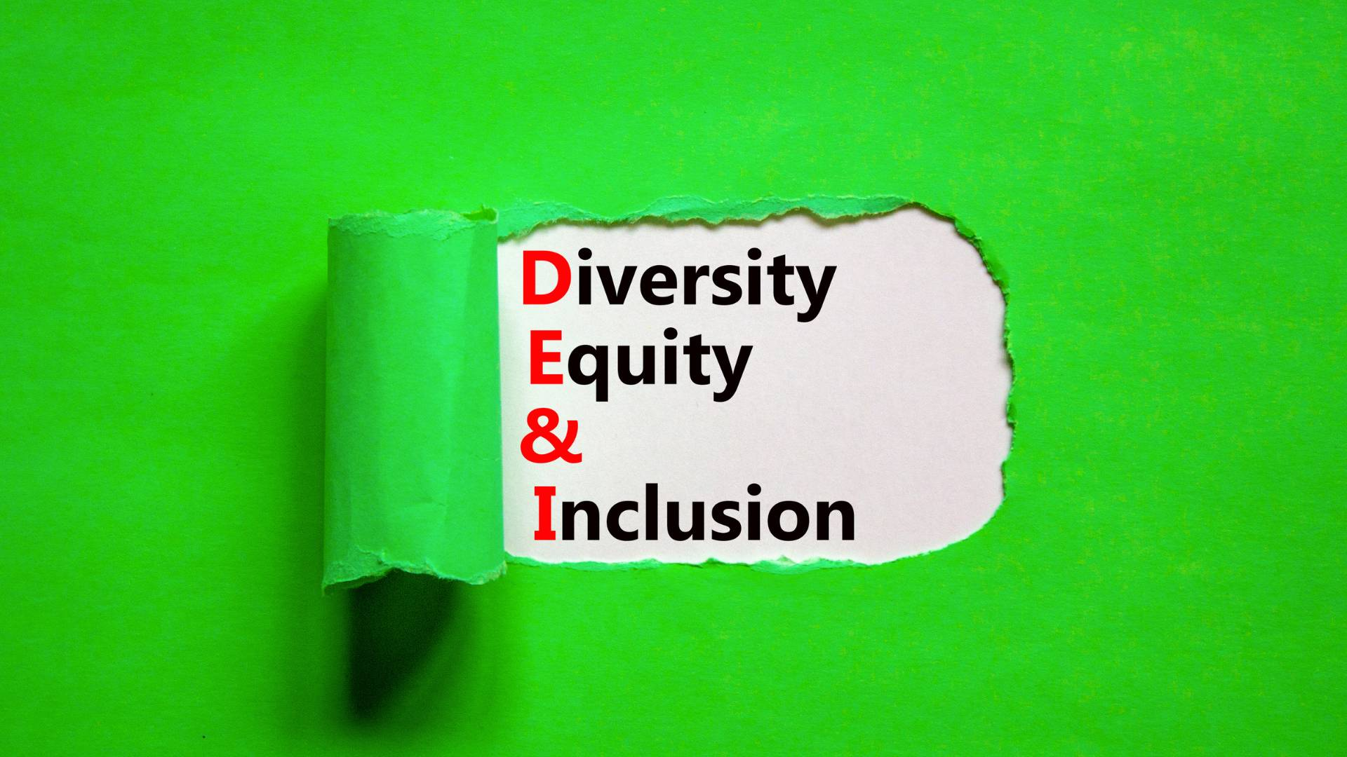
DEI Concepts and Strategies
Core Concepts in DEI
Diversity: The full range of human differences (race, gender, age, disability, culture, etc.), enriching creativity and storytelling.
Equity: Ensuring fair access by addressing systemic barriers and providing tailored opportunities, resources, and support so everyone can contribute and succeed.
Inclusion: Actively creating spaces where everyone feels welcomed, respected, supported, and valued, encouraging full participation.
Equality: Aiming for everyone to have the same opportunities and resources; it's a desired outcome but needs equity to account for historical disadvantages.
Intersectionality: A framework recognizing how intersecting identity markers (e.g., race, gender, class) shape unique experiences of discrimination and privilege, fostering empathy and broader creative expression.
Notes:
DEI Concepts and Strategies
Diversity, Equity, and Inclusion (DEI) are fundamental principles rooted in human rights, essential for creating fair, respectful, and vibrant spaces in the performing arts.
Core Concepts in DEI are:
Diversity: The full range of human differences (race, gender, age, disability, culture, etc.), enriching creativity and storytelling.
Equity: Ensuring fair access by addressing systemic barriers and providing tailored opportunities, resources, and support so everyone can contribute and succeed.
Inclusion: Actively creating spaces where everyone feels welcomed, respected, supported, and valued, encouraging full participation.
Equality: Aiming for everyone to have the same opportunities and resources; it's a desired outcome but needs equity to account for historical disadvantages.
Intersectionality: A framework recognizing how intersecting identity markers (e.g., race, gender, class) shape unique experiences of discrimination and privilege, fostering empathy and broader creative expression.
DEI Framework in Action: Guiding Principles and Practices are
Developing a DEI Strategy (Key elements: Defining Measurable Goals, Accountability Frameworks, Support Systems for Underrepresented Professionals, Continuous Evaluation)
Why it matters? To understand and guide the strategic implementation of DEI within organizations, ensuring sustainable and impactful change.
Adopting Inclusive Language (Key elements: Guiding Philosophy, Practical Application, Continuous Adaptation)
Why it matters?To establish psychological safety, build trust, and ensure all voices feel valued, reflecting an organization's ethical commitments in daily interactions.
Building a Culture of Respect & Accountability (Key elements: Active Listening, Trust & Emotional Safety Tools, Shared Collective Responsibility, Anti-Discrimination Policies.
Why it matters? To build an environment where vulnerability is safe, communication is clear, and DEI values are consistently upheld through collective effort and clear policies.

Slide 31
Building an Adaptive Mindset and Resilience: Practical Advice and Strategies
Embracing Complexity and developing an Adaptive Mindset
Key Components:
Openness: Willingness to explore new ideas, technologies, and audience behaviors.
Resilience: Ability to handle setbacks, learn, recover, and let go of what no longer works.
Creative Problem-Solving: Finding new ways through challenges, embracing innovation (e.g., digital formats, new engagement models).
Overcoming Resistance: Adaptability to moving through fear-based resistance with openness, empathy, and creative leadership, rather than force.
Notes:
Building an Adaptive Mindset and Resilience
Embracing Complexity
Complexity is inherent in the performing arts—not an obstacle, but a living system offering creative potential.
Benefits: Leaning into complexity sparks innovation, stretches creativity, shapes stronger leaders, and enhances organizational sustainability.
Interconnectedness: Recognize that artistic freedom, operational efficiency, and financial planning are deeply intertwined, requiring a holistic view to find balance.
Soft skills like adaptability and change management, along with self-care and community support, empower us to navigate complexity with confidence
Developing an Adaptive Mindset: means staying relevant demands an adaptive mindset that sees change as an opportunity, not a threat.
Key Components:
Openness: Willingness to explore new ideas, technologies, and audience behaviors.
Resilience: Ability to handle setbacks, learn, recover, and let go of what no longer works.
Creative Problem-Solving: Finding new ways through challenges, embracing innovation (e.g., digital formats, new engagement models).
Overcoming Resistance: Adaptability to moving through fear-based resistance with openness, empathy, and creative leadership, rather than force.

Slide 32
Building an Adaptive Mindset and Resilience
Building Resilience: Practical Strategies
Understanding Reactions
Clear Communication
Co-Creating Change
Strengthening Resilience
From Insight to Action
Personal and Collective Resilience
Self-Care
Learning from Setbacks
Collective Support
Notes:
Building Resilience: Practical Strategies
Understanding Reactions: Use tools like The Change Curve to recognize and anticipate emotional stages (shock, resistance, exploration, acceptance) and typical responses during transitions.
Clear Communication: "Anchor What Stays" (remind of mission, values) and "Show the Big Picture" (timelines, plans) to build trust and calm uncertainty with honest and consistent information.
Co-Creating Change: Involve teams through "Feedback Loops" and "Change Champions" to build buy-in and share the load. People support what they help shape.
Strengthening Resilience:
Promote psychological safety (making it safe to speak up) and celebrate quick wins to build momentum and support.
From Insight to Action:
Guide planning using simple change models (e.g., ADKAR, Kotter's first 3 steps) and tools like "Stakeholder mapping" and "Risk Radar."
Within the dynamic and often challenging performing arts industry, Personal and Collective Resilience are crucial for sustained success and well-being.
These encompass essential practices such as:
Self-Care: Emphasize managing energy, setting healthy boundaries, and recognizing limits to prevent burnout and sustain well-being.
Learning from Setbacks: Reframe "failure" as a tool for growth and refinement, not an end to progress.
Collective Support: Highlight the importance of strong support networks and community-building to sustain careers through uncertainty.

Slide 33
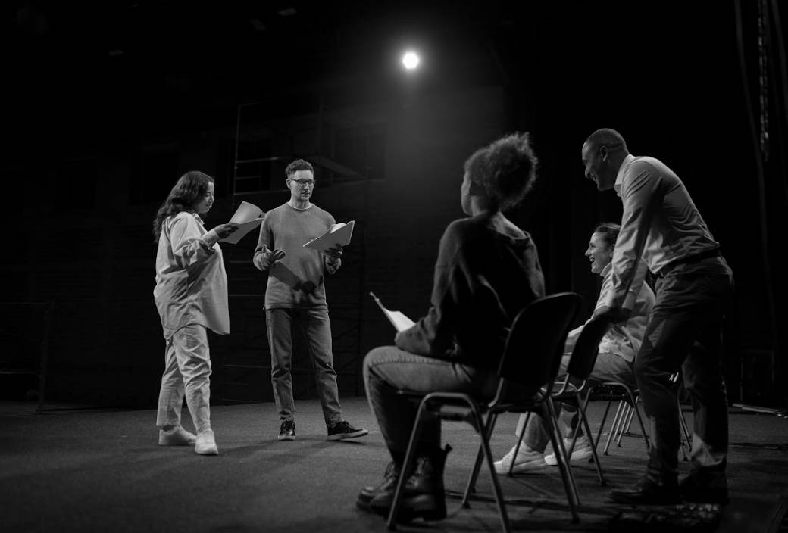
Lesson 4: Modeling Lifelong Learning and the Cross-Cutting Nature of Soft Skills

Slide 34
Topics of Lesson 4
Trainer Preparation - Beyond the Room: Enabling Soft Skills Application and Lifelong Learning
Developing a Growth Mindset for Lifelong Learning: Tools and Approaches
Understanding the Transversality of Soft Skills and Their Future Evolution
Notes:
The key pillars of lesson 4 are:
Trainer Preparation - Beyond the Room: Enabling Soft Skills Application and Lifelong Learning
Developing a Growth Mindset for Lifelong Learning: Tools and Approaches
Understanding the Transversality of Soft Skills and Their Future Evolution

Slide 35
Enabling Soft Skills Application and Lifelong Learning
Trainer Role Facilitators guide learners in transferring soft skills—communication, adaptability, collaboration—into daily professional contexts.
Key Strategies
Bridge learning to practice: design real-world tasks (e.g., role plays, “Soft Skill Scavenger Hunts”) linking training with creative work.
Measure impact: use before-and-after scenarios, peer feedback, or “Superpower Badges” to track progress and reflection.
Sustain momentum: encourage daily reflection habits, short peer-video exchanges, and creative micro-learning routines.
Outcome Promotes continuous self-awareness, peer learning, and long-term professional growth.

Slide 36
Developing a Growth Mindset
Aspect | Growth Mindset | Fixed Mindset
Challenge | Views setbacks as stepping stones Adapts strategies Maintains persistence | Avoids difficult tasks Gives up quickly Sees struggle as limitation
Feedback | Seeks feedback as a tool for improvement, Applies it to refine skills. | Feels personally attacked by criticism, dismisses or avoids feedback.
Success (of Others) | Sees others’ achievements as inspiration Studies them to learn, Celebrates peers. | Feels envious or threatened by others’ success Avoids comparison situations.
Notes:
Understanding the Transversality of Soft Skills and Their Future Evolution
The final chapter explores why soft skills are indispensable, cross-cutting competencies for navigating the complexities of the modern world—particularly in the performing arts.
It focuses on understanding the transferability of soft skills, their role in critical areas, and why their development is a strategic necessity.
The Transferability and Enduring Value of Soft Skills
Soft skills (e.g., adaptability, empathy, communication) are highly transferable across disciplines, sectors, and job titles, unlike task-specific hard skills.
OECD Definition: Abilities to responsibly use knowledge, attitudes, and values to achieve goals, enabling individuals to meet complex demands in any setting.
Future of Work: They are qualities AI and machines cannot easily replicate (emotional intelligence, critical judgment) and are crucial for lifelong learning and navigating ambiguity.
Global Competence: Promote respectful communication and collaboration across diverse cultures and professional settings.
"Fusion Skills": Blend emotional, cognitive, and practical capacities to prepare individuals for future opportunities.

Slide 37
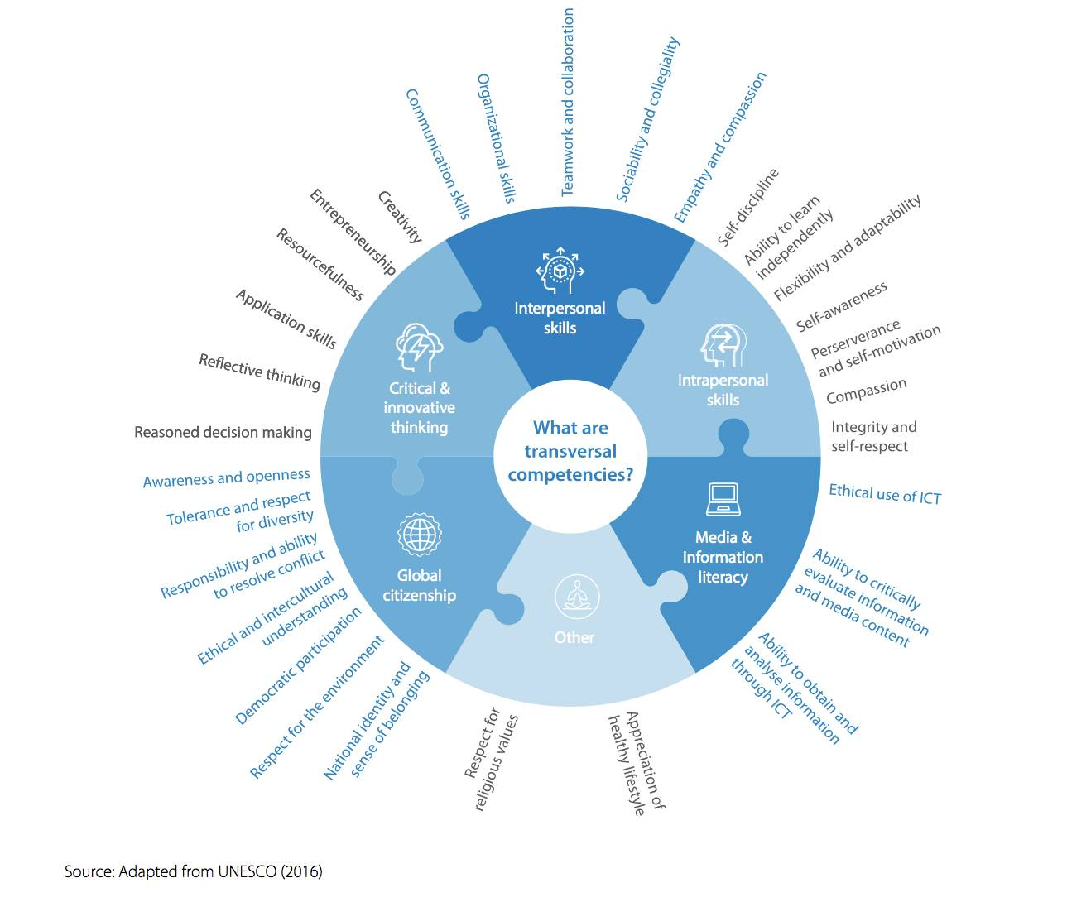
Transversality and Enduring Value of Soft Skills
The Transferability and Enduring Value of Soft Skills
OECD Definition: Abilities to responsibly use knowledge, attitudes, and values to achieve goals, enabling individuals to meet complex demands in any setting.
Future of Work: They are qualities AI and machines cannot easily replicate (emotional intelligence, critical judgment) and are crucial for lifelong learning and navigating ambiguity.
Global Competence: Promote respectful communication and collaboration across diverse cultures and professional settings.
"Fusion Skills": Blend emotional, cognitive, and practical capacities to prepare individuals for future opportunities.
Notes:
Understanding the Transversality of Soft Skills and Their Future Evolution
The final chapter explores why soft skills are indispensable, cross-cutting competencies for navigating the complexities of the modern world—particularly in the performing arts.
It focuses on understanding the transferability of soft skills, their role in critical areas, and why their development is a strategic necessity.
The Transferability and Enduring Value of Soft Skills
Soft skills (e.g., adaptability, empathy, communication) are highly transferable across disciplines, sectors, and job titles, unlike task-specific hard skills.
OECD Definition: Abilities to responsibly use knowledge, attitudes, and values to achieve goals, enabling individuals to meet complex demands in any setting.
Future of Work: They are qualities AI and machines cannot easily replicate (emotional intelligence, critical judgment) and are crucial for lifelong learning and navigating ambiguity.
Global Competence: Promote respectful communication and collaboration across diverse cultures and professional settings.
"Fusion Skills": Blend emotional, cognitive, and practical capacities to prepare individuals for future opportunities.

Slide 38
Transversality and Enduring Value of Soft Skills
The 10 Soft Skills of the Future (World Economic Forum):
Analytical thinking
Resilience, flexibility, and agility
Leadership and social influence
Creative thinking
Motivation and self-awareness
Technological literacy
Empathy and active listening
Curiosity and lifelong learning
Talent management
Service orientation and client focus
Notes:
The 10 Soft Skills of the Future (according to the World Economic Forum):
These skills are vital for success, resilience, and meaningful impact in a rapidly changing, digitally transformed world:
Analytical thinking
Resilience, flexibility, and agility
Leadership and social influence
Creative thinking
Motivation and self-awareness
Technological literacy
Empathy and active listening
Curiosity and lifelong learning
Talent management
Service orientation and client focus
Interested to learn more: World Economic Forum “Future of Jobs Report” 2025 (Link)

Slide 39
Transversality and Enduring Value of Soft Skills
Soft Skills in Action - 5 Diverse Role Application:
in Adopting Sustainable Practices
in Navigating Technological Evolution
for an Entrepreneurial Mindset
in Cross-Sectoral Work
for Career Development and Mobility
Notes:
5 Diverse Role Applications of Soft skills:
i. Role in Adopting Sustainable Practices:
Transform sustainability from a checklist to a collaborative practice.
Help navigate complexity and uncertainty (Adaptability, problem-solving).
Enable collective action (Communication, empathy, interpersonal skills).
Drive creative innovation for eco-friendly solutions.
ii. Role in Navigating Technological Evolution:
Crucial for a human-centered and inclusive digital future
Address human challenges of digital adoption (e.g., managing pressure, discomfort with change, feelings of exclusion).
Key skills: Communication, Adaptability, Problem-Solving, Empathy, Collaboration, Lifelong Learning, Leadership.
iii.Role for an Entrepreneurial Mindset:
The foundation for innovation, adaptability, and risk-taking
Handling uncertainty and risk with resilience, flexibility, and the ability to learn and adapt.
Thinking Differently: Creative and analytical skills for identifying needs, developing novel solutions.
Mobilizing People: leading with empathy, communicating to inspire and bring others on board.
Sustaining Momentum: Staying motivated, always learning, and building long-term professional relations.
iv.Role in Cross-Sectoral Work:
Essential for building trust and co-creating solutions across diverse fields.
Bridging Divides: Empathy, active listening, respectful communication.
Activating Creative Potential: Curiosity, creativity, analytical thinking at intersections.
Facilitating Policy: Leadership, social influence, clear communication for advocacy.
Optimizing Resources: Persuasion, storytelling, relationship-building for partnerships.
Human Capital Development: Interpersonal strengths like empathy, accountability, persistence for impactful work.
v. Role for Career Development and Mobility:
Vital for navigating project-based work, freelance conditions, and intense collaboration in the performing arts.
Enable professionals to handle highs and lows, adapt to new directions, bounce back from setbacks, and maintain career momentum.
Essential for coordinating complex productions, engaging stakeholders, and building long-term professional relationships.
Understanding and recognizing the transversal nature of soft skills across all fields is key to refining a future-ready mindset. Developing these skills not only offers personal advantages but also opens doors for collective development

Slide 40
Activity C2.A3
Navigating Your Learning Journey with the “Waze” Metaphor

Slide 41
Chapter 2 Reflection & Key Takeaways
What are your 2–3 key words from this chapter?
Why do these stand out for you?
Share with the group and listen for common threads.
Notes:
Use this moment to consolidate learning from Chapter 2.

Slide 42






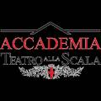





THANK YOU
Funded by the European Union. Views and opinions expressed are however those of the author(s) only and do not necessarily reflect those of the European Union or he European Education and Culture Executive Agency (EACEA.) Neither the European Union nor EACEA can be held responsible for them.
Project Number- 101139932

